Slide 1

GCIS-124
Software Development & Problem Solving
5: Data Structures I

Slide 2

Much of the content we are going to talk about today is review from the first course in this sequence.
Some of it will be discussed very quickly unless there are questions. If you have a question, please ask!

Slide 3





Data Structures
In this unit we will begin exploring abstract data types.
An abstract data type describes the behavior of a data structure from the perspective of its user without providing any implementation details.
Every abstract data type (ADT) may be implemented in more than one way.
When solving a new problem, choosing the most efficient implementation is just as important as choosing the correct data structure.
We will examine several different abstract data types, and implement each in multiple ways. Topics will include:
Queues
Generics
Lists
Iterators
The Java Collections Framework (JCF)
Today we will specifically focus on a data structure with which you are already familiar: the queue.
You are already familiar with many data structures from the perspective of a user including arrays, queues, stacks, lists, sets, and dictionaries.
In this unit we will learn how different implementations of many of these data structures work.
We will also examine the situational strengths and weaknesses of each implementation in terms of complexity (both space and time).

Slide 4


Abstract Data Types
A data structure is a grouping of related data.
We refer to the data as elements.
Most data structures provide some common operations including store, retrieve, remove, and size.
An abstract data type (ADT) defines the behavior of a data structure from the point of view of its user.
This includes the possible values and the operations available.
Choosing the ADT that provides operations suitable for solving a problem usually isn't enough.
Each ADT may be implemented in multiple ways.
Choosing the correct implementation is also important.
This requires understanding the complexity of each operation under different circumstances.
Choosing the correct abstract data type involves understanding the nature and constraints of the problem being solved.
Choosing the correct implementation involves understanding which operations will be used the most, and which of the available options provides the most efficient implementation of those operations.

Slide 5

5.1
Identify Abstract Data Types
An abstract data type describes the capabilities of a data structure from the perspective of its user without revealing any implementation details. Read each description and write the name of the abstract data type that best fits the description.
A first-in, first-out (FIFO) data structure; elements are removed in the same order that they were added. Does not provide random access. | Stores key/value pairs. Once added, a key can be used to retrieve its corresponding value. Keys are unique; if the same key is used more than once, the previous value is replaced. Keys are not maintained in any particular order. | A last-in, first out (LIFO) data structure. Elements are removed in the opposite order that they were added. Does not provide random access. | Stores unique elements, meaning that duplicates are ignored. Elements are not maintained in any particular order. | A variable length data structure that grows in size as elements are added, and shrinks as they are removed. Elements are maintained in the order that they are added, and can be accessed using an index.

Slide 6
5.1
Identify Abstract Data Types
An abstract data type describes the capabilities of a data structure from the perspective of its user without revealing any implementation details. Read each description and write the name of the abstract data type that best fits the description.
A first-in, first-out (FIFO) data structure; elements are removed in the same order that they were added. Does not provide random access. | Stores key/value pairs. Once added, a key can be used to retrieve its corresponding value. Keys are unique; if the same key is used more than once, the previous value is replaced. Keys are not maintained in any particular order. | A last-in, first out (LIFO) data structure. Elements are removed in the opposite order that they were added. Does not provide random access. | Stores unique elements, meaning that duplicates are ignored. Elements are not maintained in any particular order. | A variable length data structure that grows in size as elements are added, and shrinks as they are removed. Elements are maintained in the order that they are added, and can be accessed using an index.
QUEUE
DICTIONARY
STACK
SET
LIST

Slide 7

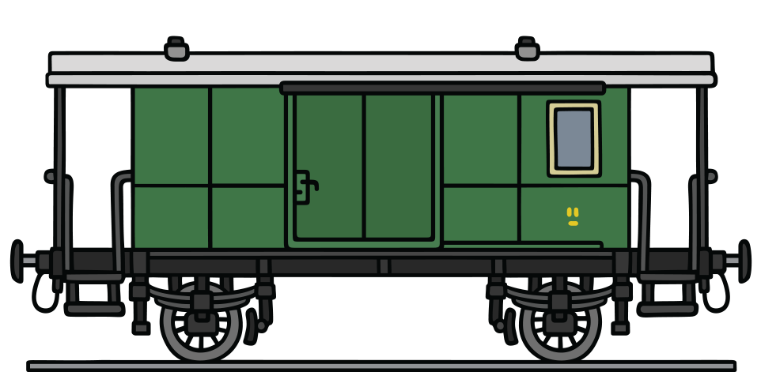
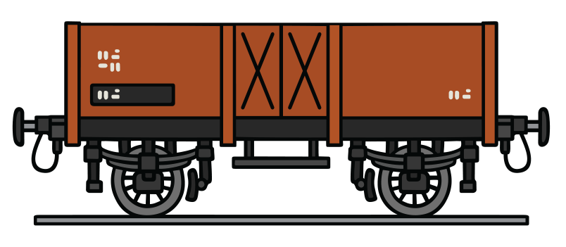
Recursive Data Structures
By now, you all know that a recursive function is one that calls itself.
Similarly, a recursive data structure is one that comprises a class (or classes) that has at least one field of its own type.
These kinds of data structures can be used to build linked sequences.
A linked sequence can be used as the basis for implementing many different data structures.
The simplest kind of recursive data structure is the node, which typically has two fields:
A value of some type, e.g. an int.
A reference to the next node in the sequence (which may be null).
A sequence of nodes can be created by joining the nodes together - each of which refers to the next node in the sequence.
The first node is referred to as the head.
The last node is referred to as the tail - the tail's next node is null.
Let's examine how nodes work by using an analogy that most of you should intuitively understand: train cars.

Slide 8
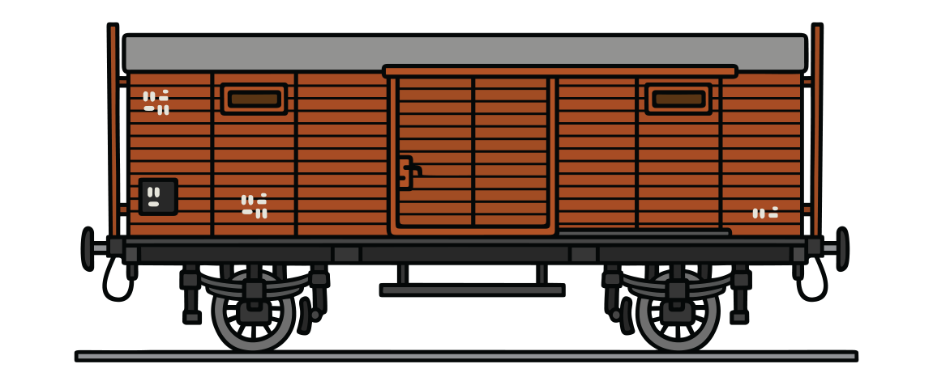

Visualizing a Linked-Sequence of Nodes
Every train car carries something of value inside of it, e.g. cargo, passengers, or the engineer.
Each train car is connected to the next car in the train.
Together, the sequence of cars form the train.
The first car is the head and the last car is the tail of the sequence. The tail has no next car.
head
tail
Node
value
5
Node
value | next
6
Node
value | next
2
Node
value | next
1
next
null
Every node has a value as well, e.g. an int or a String.
Each node has a reference to the next node in the sequence that connects them together.
Together the nodes form a sequence of nodes.
The first node is the head and the last node is the tail of the sequence. The tail has no next node.

Slide 9
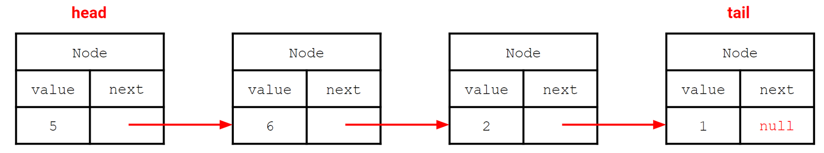
5.2
Visualizing a Sequence of Nodes
The diagram below is an example of a "box-and-pointer" visualization of the sequence of nodes containing the values 5, 6, 2, and 1. Drawing diagrams like this can help to understand how the objects in a sequence work and are connected together. Try it now!
Using a sheet of paper and a pen or pencil (or a whiteboard!), draw a separate "box-and-pointer" diagram for-each of the following sequences. Be sure to label the head and the tail of each sequence:
1
2, 3
5, 7, 11, 13
Now add a new value to the end of each sequence. How does the "tail" in each sequence change?

Slide 10
5.3
A Node Class
We will be using nodes to implement some of the abstract data types that we talk about in this unit. The first step to creating any node-based data structure is to create a Node class.
Node
- value: String - next: Node
+ <<create>> Node(value: String) + <<create>> Node(value: String, next: Node) + setValue(value: String) + getValue(): String + setNext(next: Node) + getNext(): Node
Create a new package named "unit05.mcf" (short for "my collections framework") and use it for all of the code that you write in this unit unless otherwise instructed.
Create a new Java class named "Node".
Use the UML diagram to the left as a guide to implementing your Node class.
The string representation of a node should match the following format: "<value> -> <next>"
e.g. "5 -> 4 -> null"
Define a main method with an appropriate signature and use it to test your new Node class.

Slide 11
Queues
A queue is an abstract data type that provides at least the following operations:
enqueue - adds an element to the back of the queue.
dequeue - removes an element from the front of the queue.
size - returns the number of elements currently in the queue.
A queue may also provide additional operations:
front - returns but does not remove the element at the front of the queue.
back - returns but does not remove the element at the back of the queue.
is empty - returns true if the queue is empty, and false otherwise.
A queue stores its elements in First-In, First-Out (FIFO) order.
The first element to be enqueued is the first element to be dequeued.
The last element to be enqueued is the last element to be dequeued.
The queue abstract data type defines its behavior from the perspective of its user, but does not include implementation details.
What Java feature can be used to define required behavior without providing an implementation?
A real-world analog for a queue is a line at the bank, a grocery store checkout, or the DMV.
People get into line as they arrive, entering at the back...
The person that is first-in the line is the person that is first-out when the next employee is available.
Another way to say this is that the person that has been in line the longest is the next to leave.
When people do leave, they leave from the front of the line.
Notes:
A: An interface!

Slide 12
5.4
The Queue Abstract Data Type
Remember: the Queue abstract data type should define the behavior that all queues have without describing the implementation. A Java interface is the ideal mechanism for defining behavior without implementing it. Create an interface for a Queue.
<<interface>> Queue
+ enqueue(value: String) + dequeue(): String + size(): int + front(): String + back(): String + isEmpty(): boolean
Use the UML to the left as a guide to create a new Java interface named "Queue" in the mcf package.
Use the UML diagram as a guide to create an interface to represent a Queue.

Slide 13
Node-Based Queues
One possible implementation of a queue is built using a linked sequence.
You should recall that a linked sequence is defined as:
The empty sequence, which contains no values and is represented as null.
At least one node that contains:
A value of some type, e.g. an String.
A reference to the next node in the sequence, which may be null.
A node-based queue keeps track of three values.
The node at the front of the queue.
The node at the back of the queue.
The size of the queue - the total number of nodes including the front and the back.
There are some special conditions that need to be considered:
If the queue is empty, both the front and back are null.
If there is only one value in the queue, both the front and back refer to the same node.
A node-based queue uses linked nodes to store values. The oldest node is the front...
NodeQueue
front
back
size | 3
Node
value | "a"
next
Node
value | "b"
next
Node
value | "c"
next | null
...and the newest node is the back.
Any remaining values added in between form a linked sequence between the front and back.

Slide 14
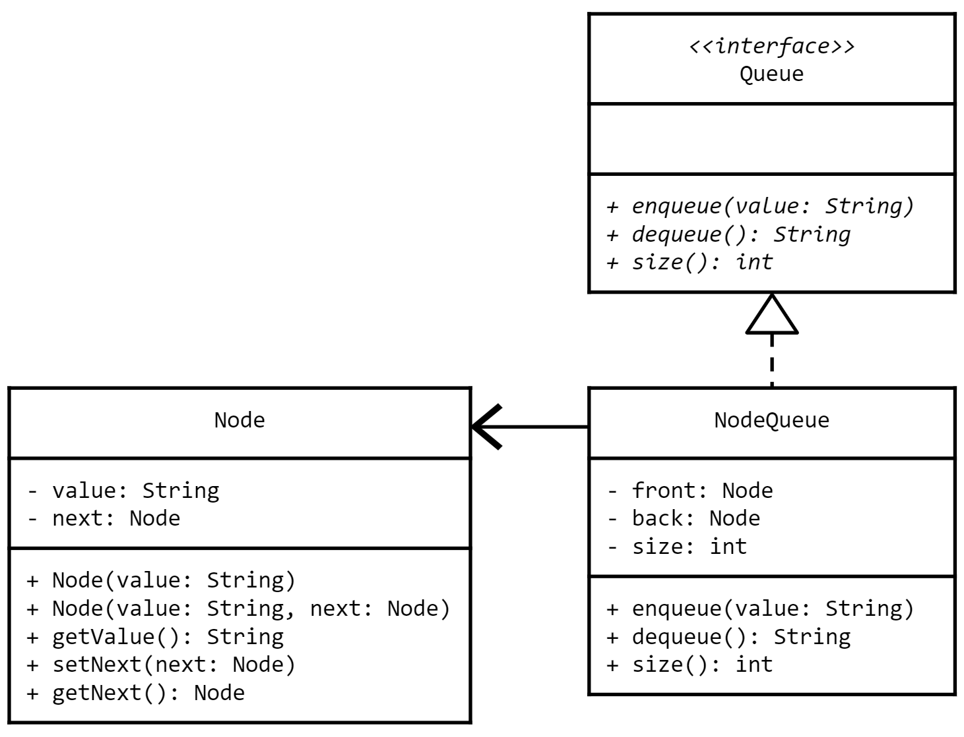
5.5
A Node-Based Queue
Our first implementation of a Queue will use Nodes to store the values that are added to the Queue. Begin your implementation of a Node-based Queue.
Create a new Java class named "NodeQueue".
Use the UML to the left as a guide to begin implementing your NodeQueue.
For now focus on fields and constructors.
Implement the size method.
Stub-out any other methods required by the Queue interface.
Implement a toString() method that returns a string in the format "<size>, <front>"
e.g. "2, 5 -> 4 -> null".
Define a main method with the appropriate signature and use it to create an instance of the new class and print it to standard output.
In UML, an association indicates that one class uses another in some way, e.g. as a field. This is indicated with a solid line ending in an open arrow.

Slide 15
A Closer Look at Enqueuing
An empty queue has a size of 0, and both the front and back are null.
When the first value is enqueued, a new node is created to hold the value.
As each new value is enqueued, a new node is created and becomes the new back of the queue.
Queue
size | 0
front | null
back | null
Queue
size | 0
front | null
back | null
Queue
size | 1
front | null
back
1
Node
value | "a"
next | null
2
Node
value | "a"
next | null
Node
value | "b"
next | null
Both the front and the back are changed to refer to the new node, and size is incremented.

Slide 16
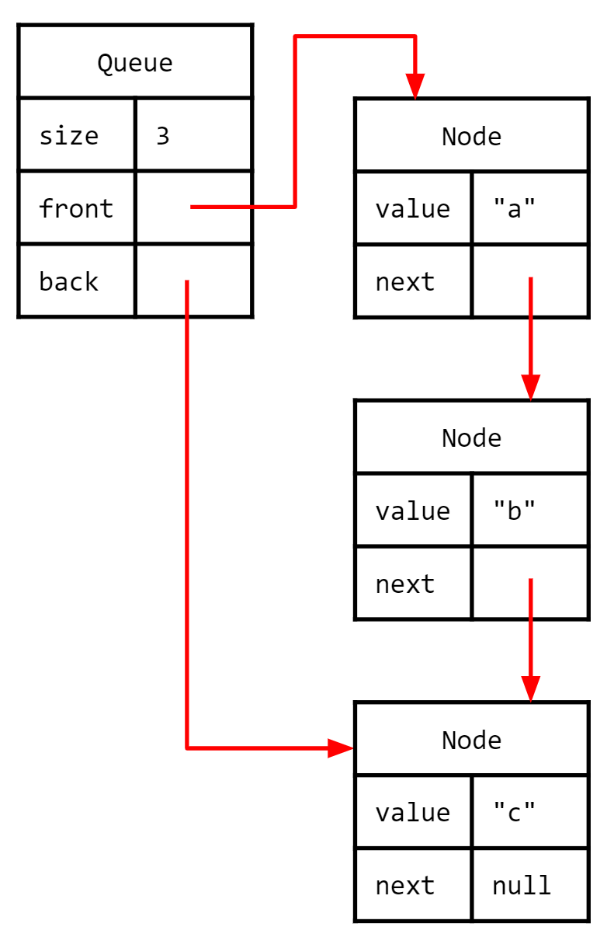
5.6
Enqueue Using Nodes
The first essential functionality that we will implement on the Node-based Queue is the enqueue method, which adds new elements to the back of the queue.
Open your NodeQueue class and implement the enqueue method.
Make a new Node with the value that is being enqueued..
If the front is null, the new Node becomes the new front and back of the queue.
Otherwise, the new Node is the new back of the queue.
Don't forget to increment size!
Use main to enqueue a few values and print the queue.

Slide 17
A Closer Look at Dequeuing
When a value is dequeued, it is always removed from the front of the queue.
The new front is changed to the old front's next node, and size is decremented.
If the front's next node is null, then the queue is empty; both the front and back are set to null.
Queue
size | 2
front
back
Queue
size | 2
front
back
Queue
size | 0
front | null
back | null
Node
value | "a"
next
1
Node
value | 123
next
0
Node
value | 123
next | null
Node
value | "b"
next | null
Node
value | "b"
next | null

Slide 18
5.7
Dequeue Using Nodes
We can add new elements to the queue, which is great! But we can't actually remove anything from the queue, which is not so great. Finish implementing the Node-based Queue by added a dequeue method.
Open your NodeQueue class and implement the dequeue method.
Save the front node's value in a temporary variable.
Make the new front the old front's next node.
If the new front is null, set back to null as well!
Don't forget to decrement size!
Return the temporary variable.
Use main to dequeue a few values and print them out. Print your queue as well.

Slide 19
Array-Based Queues
The queue abstract data type defines the following behavior:
Elements are enqueued at the back.
Elements are dequeued from the front.
The order in which elements are added is maintained - a queue is a FIFO data structure.
Most data structures can be implemented in more than one way.
The above description does not include any information about the implementation of the queue.
So far we have implemented a queue using a linked sequence of nodes, but that is only one possible implementation of a queue.
Another possible implementation stores elements in a circular array.
Separate indices for the front and back of the queue are saved as fields.
As elements are enqueued, the back index is incremented.
As elements are dequeued, the front index is incremented.
From the perspective of the user, both implementations work exactly the same.
The implementation details are hidden behind the Queue interface.
Code written to use the interface will work with either implementation.
An array-based queue uses an array to store the elements that are added to the queue.
null | "a" | "b" | "c" | "d" | null
0 | 1 | 2 | 3 | 4 | 5
front
back
Fields are used to keep track of the front and back index in the array.
Each time an element is enqueued or dequeued, one of the indices is incremented; the "head" chases the "tail."
When either index reaches the end of the array, it will need to wrap around to the beginning.
Notes:
Back represents an index where new element will be added.

Slide 20
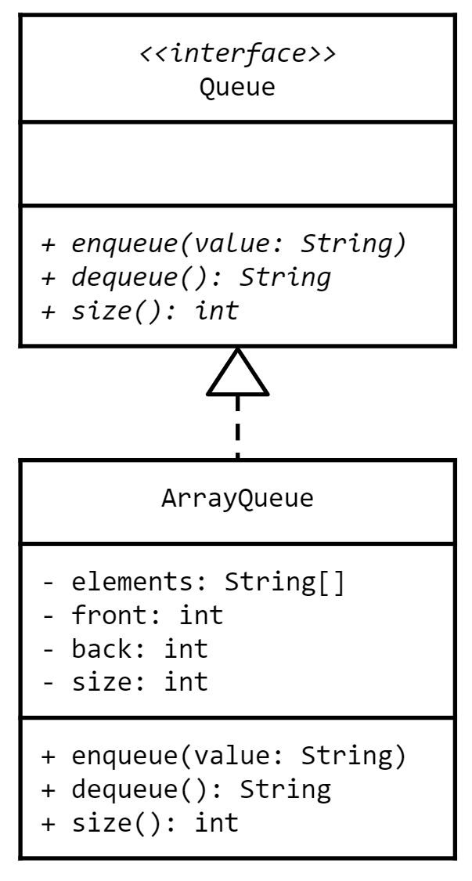
5.8
An Array-Based Queue
We've just finished implementing a Node-based Queue, but most abstract data types can be implemented in more than one way. Different implementations may offer performance benefits (and drawbacks) in some situations. Let's try implementing a Queue using an array.
Create a new Java class named "ArrayQueue".
Use the UML to the left as a guide to begin implementing your ArrayQueue.
For now focus on fields and constructors.
Implement the size method.
Stub-out any other methods required by the Queue interface.
The string representation of an ArrayQueue should match the format "<size>, <array>".
Hint: use Arrays.toString(array)
e.g. "3, [3, 2, 7, 0, 0, 0]"
Define a main method and use it to test your queue.

Slide 21
A Closer Look at Enqueuing
As you know, an array is created to be some fixed size, and Java fills it with a default value, e.g. null.
When a new element is enqueued, it is added at the back index, and the back index is incremented.
If after incrementing the back index is equal to the array length, it wraps around to the beginning.
null | null | null | null | null
0 | 1 | 2 | 3 | 4
null | null | null | null | null
0 | 1 | 2 | 3 | 4
null | null | "c" | "d" | "e"
0 | 1 | 2 | 3 | 4
"a"
front
back
front
back
back
back
front
back
"a" | null | null | null | null
0 | 1 | 2 | 3 | 4
"b"
If the size is equal to the length before an enqueue, the array is full and will need to be resized.
Initially both front and back indices point to the same index: 0.
front
back
back
"f" | "g" | "c" | "d" | "e"
0 | 1 | 2 | 3 | 4
The size starts at 0 and is incremented each time an element is enqueued.
"a" | "b" | null | null | null
0 | 1 | 2 | 3 | 4
"c"
front
back
front
back
back

Slide 22
5.9
Enqueue Using an Array
Although enqueuing into an Array-based Queue can be fairly straightforward in most cases, some edge cases can be relatively complicated. Try implementing enqueue using an array.
Open your ArrayQueue class and implement the enqueue method.
Add the new element to the back index.
Increment the back index. Be sure to wrap around if necessary.
Hint: use modulo with the length of the array.
Don't forget to increment size.
For now do not worry about resizing (yet).
Compile your class.
Don't worry about error handling at this point.
What potential error(s) may occur?
How might you handle the error(s) if they do occur?
Use main to enqueue a few values and print the queue.
"a" | "b" | "c" | null | null
0 | 1 | 2 | 3 | 4
front
back

Slide 23
A Closer Look at Dequeuing
When dequeuing, the element at the front index is returned and the front index is incremented.
If after incrementing the front index is equal to the array length, it wraps around to the beginning.
There are at least two ways to handle calling dequeue on an empty queue...
"a" | "b" | "c" | null | null
0 | 1 | 2 | 3 | 4
"d" | "e" | "f" | null | null
0 | 1 | 2 | 3 | 4
null | null | null | null | null
0 | 1 | 2 | 3 | 4
null
front
front
back
front
back
front
front
back
If the size is 0 after a dequeue, the queue is empty.
The easiest is to simply return null. But this obfuscates the problem because it is possible to enqueue a null value.
It is important to set the value at the front index to null before the index is incremented.
null | null | null | null | null
0 | 1 | 2 | 3 | 4
This is because keeping a reference to the value will prevent it from being garbage collected.
Alternatively, an exception may be thrown.
front
back

Slide 24
5.10
Dequeue Using an Array
Dequeuing from an Array-based Queue is also usually straightforward and uses logic similar to the enqueue method for edge cases. Try implementing the dequeue method on your queue now.
Open your ArrayQueue class and implement the dequeue method.
Save the element at the front index in a temporary variable.
Set the value at the front index to null. Why?
Increment the front index. Be sure to wrap around if necessary.
Don't forget to decrement size!
Return the temporary variable.
Compile your class.
Don't worry about error handling at this point.
What potential error(s) may occur?
How might you handle the error(s) if they do occur?
Use main to dequeue a few values and print them out. Print your queue as well.
"a" | "b" | "c" | null | null
0 | 1 | 2 | 3 | 4
front
back

Slide 25
A Closer Look at Resizing
If before enqueuing the size is equal to the length of the array, then the array is full.
First, a new, bigger array is created (usually double the size of the current array).
Then, beginning at the front index in the old array, elements are copied into the new array beginning at index 0.
"f" | "g" | "c" | "d" | "e"
0 | 1 | 2 | 3 | 4
"f" | "g" | "c" | "d" | "e"
0 | 1 | 2 | 3 | 4
When the copy reaches the end of the old array, it wraps around to index 0 and continues from there.
front
back
null | null | null | null | null | null | null | null | null | null
0 | 1 | 2 | 3 | 4 | 5 | 6 | 7 | 8 | 9
At this point, the array will need to be resized in order to make room for additional elements.
"c"
"d"
"e"
"f"
"g"
This will require making a new, bigger array, and copying the elements into it.
front
back
The front is set to 0 and back is set to size in the new array.

Slide 26
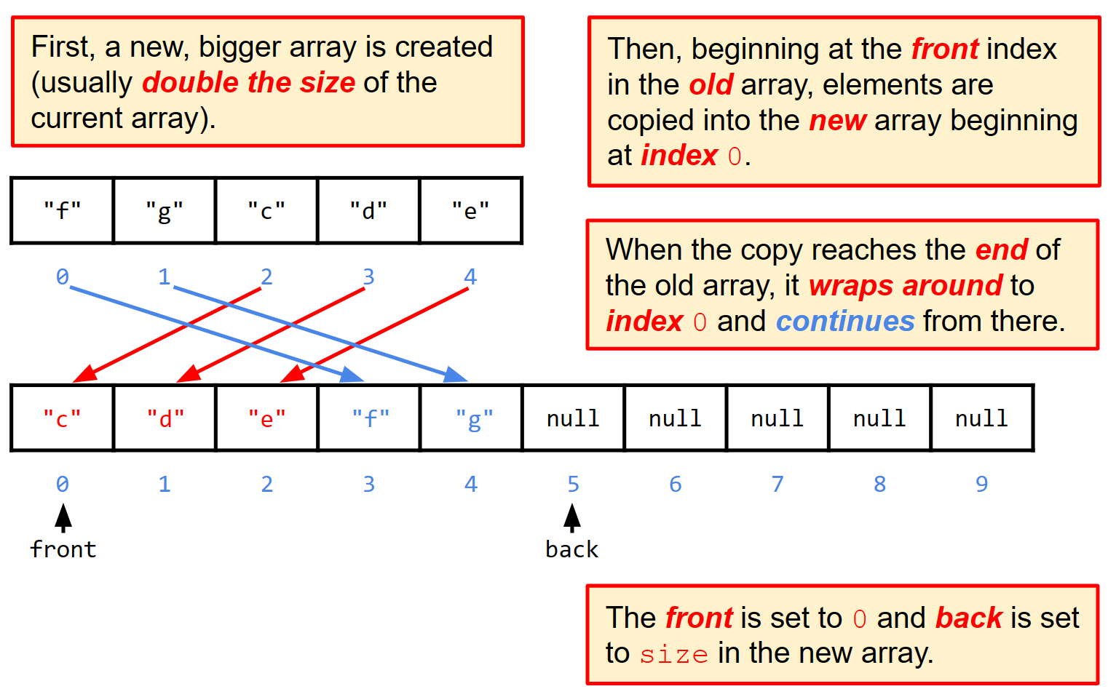
5.11
Resizing
A Node-based Queue never "fills up" because we can always add another node to the back. But arrays are fixed-size, and so we may eventually run out of space. The solution is to make a new, larger array and copy the elements into it.
Open your ArrayQueue class and navigate to the enqueue method and modify it to resize the array if the array is full.
Make a new array that is double the size.
Use a loop to copy beginning from the front index in the old array and into index 0 in the new array.
Hint: The destination index starts at 0 and ends at size-1
Hint: The source index is (front + destination) % size.
Don't forget to set front to 0 and back to size!
Compile your class.

Slide 27
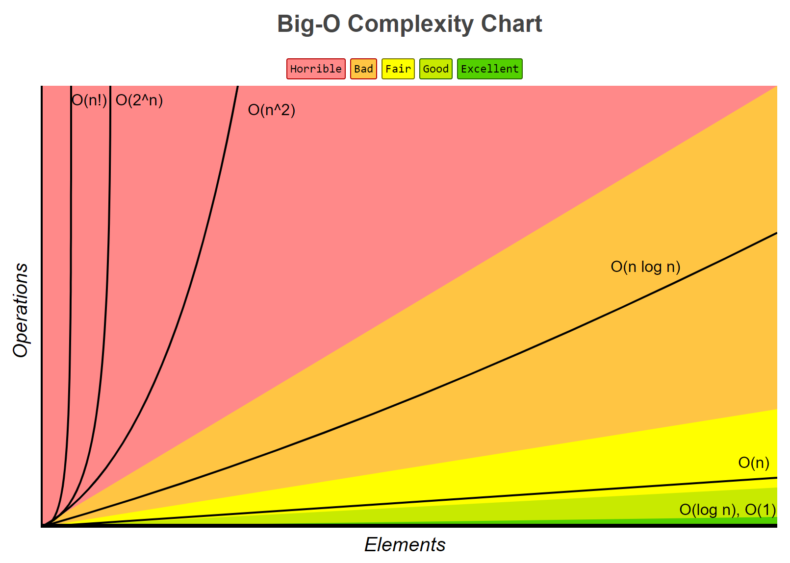
Queue Complexity
So far, we have discussed two different implementations of the queue abstract data type: node-based and array-based.
From the perspective of the user, there is no difference between the behavior of the two implementations.
Choosing which implementation to use requires a deep understanding of the strengths and weaknesses of each under different circumstances.
The expected time complexity of all operations on both queue implementations is constant time (O(1)).
In fact, this is also the worst case time complexity for all operations on a node-based queue.
The worst case time complexity for enqueue on an array-based queue occurs when the array is full.
This requires that the elements be copied into a new array; a linear time operation (O(n)).
Doubling the size of the array each time it is resized will ensure that the copy operation is rare.
If the maximum number of elements is known, the array may be pre-allocated to avoid copying entirely.
The space complexity of both implementations is different.
Creating a node object for every element in a node-based queue uses more memory than an array.
On the other hand, the array-based queue usually over-allocates its array, and so uses more memory.
Generally, when there is a tradeoff between time complexity (speed) and space complexity (memory), we prefer time complexity.
That being said, there is so little difference between the time complexity of both implementations (except in rare circumstances) that either implementation is appropriate for most problems.

Slide 28
Generics
The queue interface and implementations that we have written so far only work with Strings.
If we wanted a queue that worked with doubles, or ints, or Goats, we would need to make a new interface and implementation by basically copy/pasting, and doing a search & replace with the new type.
It turns out that Java has a feature that does essentially the same thing without having to write a new class each time: generics.
A generic type declares one or more type parameters between angle brackets (<>).
public class Foo<Bar, Bel> {...}
public interface Operation<N>{ ... }
The type parameters should never use the name of a real type, e.g. String, Scanner, etc.
The type parameter can be used inside the class as though it is a real type, e.g. as variables, parameters, return types, etc.
When a variable of the generic class is declared, a real type is specified in place of each type parameter, e.g. Operation<String> myClass;
The Java compiler makes sure that only the type(s) specified when the variable is declared are used with this instance of the generic class.
A generic class declares one or more type parameters in angle brackets (<>).
1 public class Container<T> {
2 private T value;
3
4 public Container(T value) {
5 this.value = value;
6 }
7
8 public T getValue() {
9 return value;
10 }
11
12 public void setValue(T value) {
13 this.value = value;
14 }
15 }
The fake type name(s) can then be used as though they are real types inside the body of the class, i.e. as fields, parameters, and return values.
When a variable of the generic class is declared, real types are substituted for the fake ones.
Notes:
A generic is a class or method that works with many data types. It gives classes an ability to handle multiple data types.
A generic class uses a type parameter:
✅ Why generics exist
Before Java 5:
everything was Object
constant casting
runtime crashes
Generics moved errors to compile time.
Safer + faster development.
✅ Multiple type parameters
class Pair<K, V> {
K key;
V value;
}
✅ Bounded generics
Sometimes you want restrictions.
Example:
class NumberBox<T extends Number> {
T value;
double square() {
return value.doubleValue() * value.doubleValue();
}
}
✅ Multiple bounds
<T extends Number & Comparable<T>>
T must:
be a Number
implement Comparable

Slide 29
A Closer Look at Generics
A generic type declares one or more type parameters with fake type names.
When a variable of the generic type is declared and/or instantiated, a real type is specified for-each type parameter...
When each instance is created with a real type, it is as though the Java compiler does a search and replace...
1 public class Container<T> {
2 private T value;
3
4 public Container(T value) {
5 this.value = value;
6 }
7
8 public T getValue() {
9 return value;
10 }
11
12 public void setValue(T value) {
13 this.value = value;
14 }
15 }
Note that the diamond operator (<>) can be used on the right side of an assignment (the types are inferred from the left).
1 public class Container< T > {
2 private T value;
3
4 public Container( T value) {
5 this.value = value;
6 }
7
8 public T getValue() {
9 return value;
10 }
11
12 public void setValue( T value) {
13 this.value = value;
14 }
15 }
String
String
Container<String> c = new Container<>("abc");
String
c.setValue("def");
c.setValue(123);
String
String
From that point forward, only the specified type can be used with that specific instance of the generic type.
The fake type names can then be used in the class as though they are a real type, i.e. as fields, parameters, or return values.
...and the type parameter is replaced with the real type wherever it occurs in the class.
Trying to use a different type with the same instance will cause a compiler error.

Slide 30
5.12
Making Queue Work With any Type
The Queue interface that we used to implement the node and array-based queues only works with strings. Thankfully, Java's generics syntax allows us to define classes and methods that will work with any type. Let's modify our existing classes to use generics instead of strings.
<<interface>> Queue<E>
+ enqueue(value: E) + dequeue(): E + size(): int
Open the Queue interface and convert it into a generic type.
Add a type parameter to the interface declaration.
While you can use any fake name that you'd like, it is customary to use E (short for element) as the name of the type parameter in a generic data structure.
Replace instances of the String type with the type parameter where appropriate.
Compile your interface to make sure that it is syntactically correct.
Note that your queue implementations will no longer compile unless they are updated!

Slide 31
Combining Generics
When a variable of a generic type is declared within the body of a class, it is usually the case that a real type must be provided for its type parameter(s).
e.g. Container<String> container;
One common exception to this rule is within the body of a generic type.
The generic type may use its own type parameter when declaring variables, fields, parameters, or return values of a generic type.
When a real type is provided for its own type parameter, it is propagated to any variables within the class that use the same type parameter.
Currently our Node implementation only works with Strings.
If we are to make a NodeQueue that can hold any type of element, we will need to make the Node class generic as well.
As usual, this will involve adding a type parameter to the Node class declaration, and we will replace all references to the String type with the type parameter.
Different nodes in the same linked sequence will always store the same type of values, and so we will want to use the same type parameter for the next Node.
A generic type may use its own type parameter when declaring variables of a generic type rather than specifying some real type.
1 public class Warehouse<T> {
2 private Container<T> container;
3
4 public Warehouse(T value) {
5 container = new Container<>(value);
6 }
7
8 public Container<T> getContainer() {
9 return container;
10 }
11 }
When a real type is provided for the type parameter, the same type is propagated to the variables in the class that use the same type parameter.
1 Warehouse<String> wh = new Warehouse<>("abc");
2 Container<String> c = wh.getContainer();
3 String value = c.getValue();
Notes:
If I use T instead of Intf<String> it is an error. It must be implemented at class level.
public class IntfC implements Intf<String> {
@Override
public void print(String value) {
// TODO Auto-generated method stub
throw new UnsupportedOperationException("Unimplemented method 'print'");
}
}

Slide 32
5.13
Making Nodes Work With any Type (too)
The Node class can only store string values. If we want to use Node to store any kind of value, we'll need to make it generic. Then we'll be able to use it to implement a generic, Node-based Queue.
Open the Node class and modify it into a generic type that can store any kind of value (not just strings).
Add a type parameter to the class declaration.
Replace instances of the String type with the type parameter where appropriate.
Note that a nodes in a linked-sequence will all be of the same type, and so the reference to the next node should also be generic, i.e. private Node<E> next
The compiler will make sure that two nodes can only be linked together if the real types match.
Use your main method to create and print a few nodes that use types other than strings.
What happens when you use a primitive type like int?
What happened to your NodeQueue?
Node<E>
- E: value - next: Node<E>
+ Node(value: E) + Node(value: E, next: Node<E>) + getValue(): E + setNext(next: Node<E>) + getNext(): Node<E>
Notes:
In a Generic class definition, How do one access the method of a specific generic type package unit05.gen;
You cannot directly call methods specific to a concrete type unless you constrain the generic type.
Because inside Node<T>, Java only knows:
T is some Object
✅ Solution 1 — Use bounded generics
If you want access to methods of a specific type, constrain T:
Example: restrict to CharSequence
public class Node<T extends CharSequence>
Now Java knows:
👉 T has CharSequence methods
✅ Solution 2 — Use an interface bound
Best practice: design an interface.
interface Printable {
void print();
}
Then:
public class Node<T extends Printable>

Slide 33
Extending Generics
Type parameters must be declared along with the class or interface declaration in a generic type, i.e.
public class Foo<T> {}
public interface Queue<E> {}
Trying to specify a type parameter anywhere else will cause a compiler error, e.g.
public class A extends B<T> {}
When extending/implementing a generic type, one option is to make the new class generic as well by declaring a type parameter and using the same type parameter with the superclass or interface, e.g.
public class A<T> extends B<T> {}
A second option is to make the new class work only with a specific real type by specifying that type with the superclass or interface, e.g.
public class A extends B<String> {}
While the second option is easier, you will lose the flexibility that generics provide in the subclass.
In this example, class A will not be generic; it will only work with strings.
A type parameter cannot be used within the body of a class unless it is declared as part of the class.
1 public class Locker<T> extends Container<T> {
2 private boolean locked;
3
4 public Locker(T value) {
5 super(value);
6 locked = false;
7 }
8
9 public void toggleLock() {
10 locked = !locked;
11 }
12
13 @Override
14 public T getValue() {
15 return locked ? null : super.getValue();
16 }
17 }
The same type parameter(s) can then be used when extending or implementing another generic type.

Slide 34
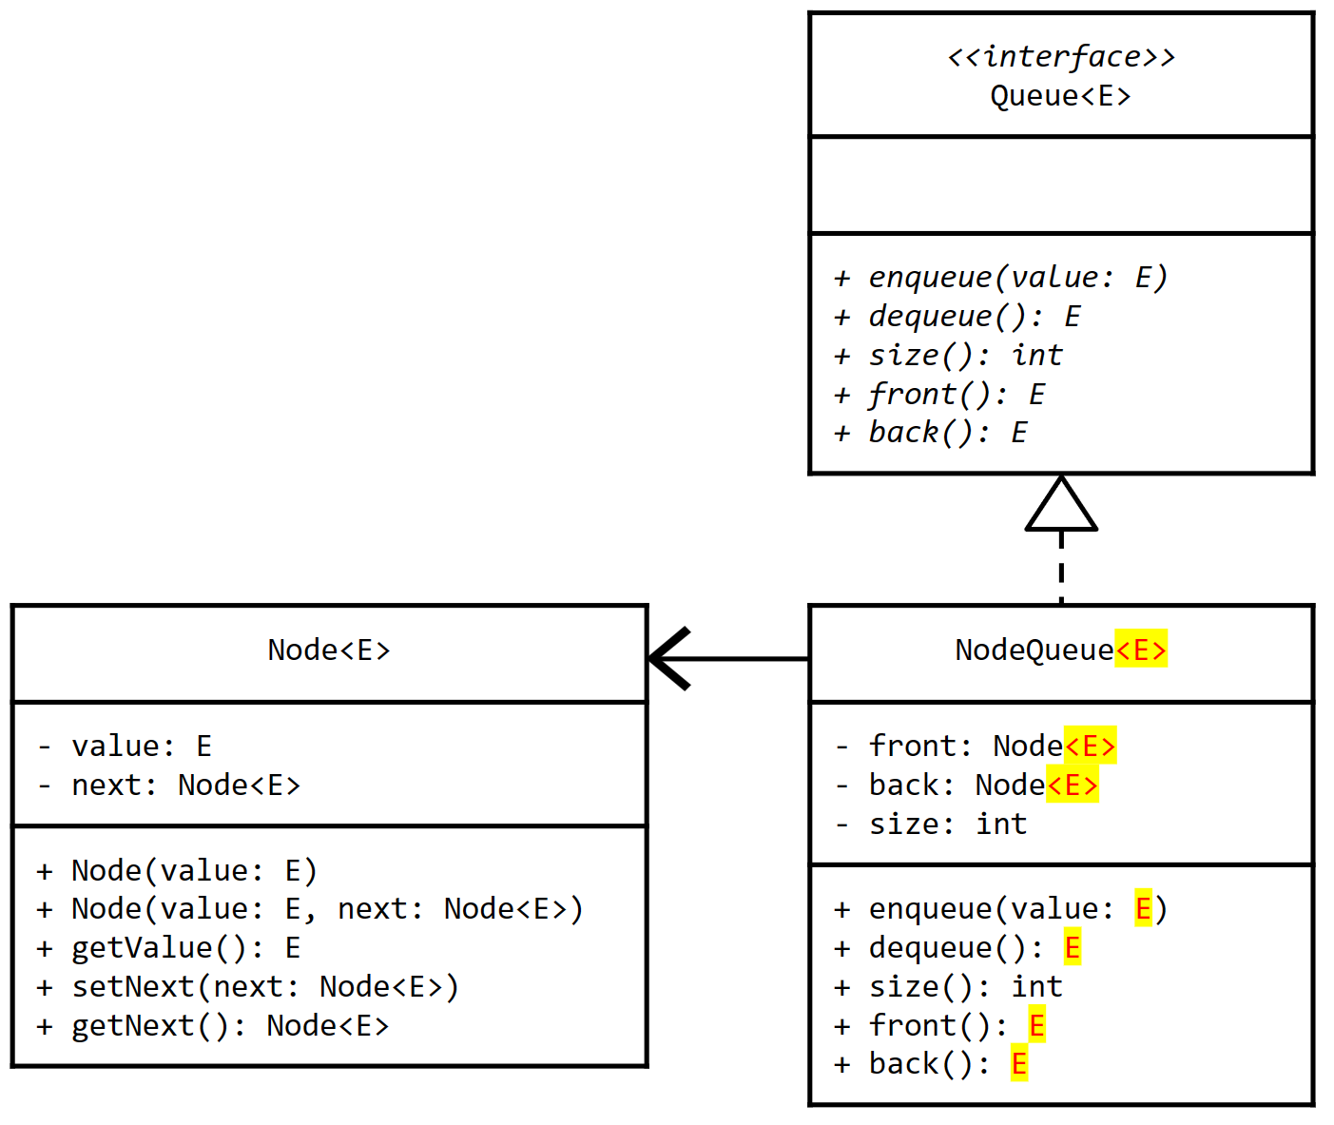
5.14
Making NodeQueue Generic
Node is the fundamental building block of a Node-based queue. Now that it's generic, we can refactor the NodeQueue to be generic as well.
Open the NodeQueue class and modify it into a generic type that can store any kind of value, not just integers.
Add a type parameter to the class declaration.
Use the same type parameter when implementing the generic Queue interface.
Modify all of the Node references to use the same type parameter.
Replace instances of the String type with the type parameter.
Use main to test your updated NodeQueue.

Slide 35
Autoboxing
(and Unboxing)
Primitive types cannot be used as the real type for a generic type parameter.
Generics only work with reference types.
So what do you do if you need a data structure that stores integers or booleans?
Thankfully, Java provides a set of wrapper classes, each of which represents a different one of the eight primitive types.
In general, the name of the wrapper class is the capitalized, fully-spelled-out name of the primitive, e.g. Integer instead of int and Character instead of char.
If a generic is needed to work with a primitive type, the corresponding wrapper class should be used in place of the type parameter, e.g.
Queue<Integer> intQueue;
Once you create an instance of a generic using one of the wrapper classes, you can use the generic with the corresponding primitive type.
Java will seamlessly and transparently translate from the primitive type to its wrapper class. This is called autoboxing.
Translating back from the wrapper to the primitive is called unboxing.
If one of the Java wrapper classes is used to create an instance of a generic type...
1 Queue<Integer> intQueue = new NodeQueue<>();
2
3 intQueue.enqueue(123);
4 intQueue.enqueue(456);
...Java will autobox primitive values of the corresponding type by transparently creating a new instance of the wrapper class with the same value to use in place of the primitive.
Integer
value | 123
Integer.valueOf(123);
The same process also works in reverse; the primitive value is retrieved from inside the wrapper. This is called unboxing.
1 int value = intQueue.dequeue();

Slide 36

Lists
A list is an abstract data type that provides at least the following operations:
append - adds a new value to the end of the list.
get - returns the value at a specific index in the list.
set - changes the value at a specific index in the list.
size - returns the number of elements currently in the list.
A list may also provide additional operations.
insert - inserts a new element at a specific index somewhere in the list. Elements after the specified index are shifted to the right.
remove - removes an element from a specific index somewhere in the list. Elements after the specified index are shifted to the left.
A list maintains elements in the order in which they are added.
A list most closely resembles a dynamically sized array.
The size grows as elements are added and shrinks as elements are removed.
However, Java does not support operator overloading, and so square brackets ([]) cannot be used.
The above description defines the list abstract data type, but does not include implementation details.
A real-world analog for a list is a to-do list.
MAKE TACOS
GO ROUND MUM'S
DO HOMEWORK
GET LIZ BACK
EAT TACOS
SORT LIFE OUT
MAKE MORE TACOS
PAY PHONE BILL
CALL MUM
TAKE OUT GARBAGE
BATHE
The size of the list dynamically changes as new tasks are added or old tasks are completed.
If the first page is filled up, additional space can be allocated so that more items can be added to the list.
Notes:
T[] abc = new T[]{};
Errror -> Can’t create generic array of T

Slide 37

5.15
The List Abstract Data Type
The List abstract data type defines the behavior that all lists must provide, but doesn't implement any of that behavior. Once again, a Java interface is the perfect way to represent an ADT. This time, let's make the List work with values of any type by making it generic right from the start.
<<interface>> List<E>
+ append(value: E) + get(index: int): E + set(index: int, value: E) + size(): int
Create a new Java interface named "List".
Use the UML diagram to the left as a guide when implementing your List interface.
Now is a good time to make sure that you don't have any problems in your project.
If you do have any errors or warnings that you are not sure how to fix, please raise your hand now!

Slide 38
Array Lists
One possible implementation of a list is built using an array.
The array is over-allocated, meaning that it is created to be large enough to hold a non-zero number of elements even when the list is empty.
The capacity of the array indicates the maximum number of elements that can be stored before the array is full.
The size of the list indicates the number of elements currently stored in the array, which is initially 0.
Unfortunately, in Java an array cannot be created using a type parameter.
e.g. E[] e = new E[5]; will cause a compiler error.
The workaround for this is to create an Object array to store the elements.
Remember that Object is the parent of all reference types in the Java language, and so any type can be stored in an Object array.
This means that the get method will need to cast the value into the correct type before it is returned.
e.g. E value = (E)elements[index];
Otherwise the only challenge is that the array needs to be resized when size is equal to its capacity.
Thankfully, this is pretty easy to do!
Using arrays and type parameters together can feel a little kludgy. Trying to create an array using the type parameter won't work...
T[] things = new T[10]; // compiler error
The hack workaround is to create an Object array, which can then be used to store any kind of value (including the type parameter).
Object[] things = new Object[10];
things[0] = anyValue; // OK!
Of course this means that a cast is needed to change the type of values in the array from Object to any other type (including the type parameter).
Object obj = things[5];
T thing = (T)obj;

Slide 39
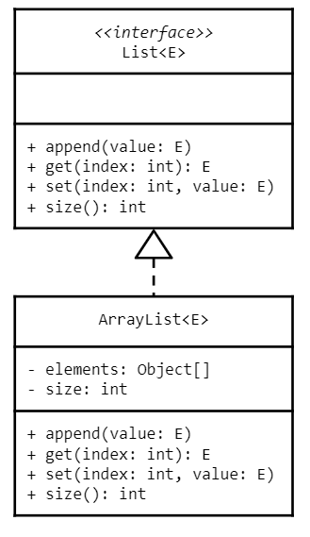
5.16
An Array-Based List
One possible implementation of the List abstract data type uses an array to store the elements in the list. The array is over-allocated to start, so that there is room to add a few elements before worrying about needing to resize (we'll handle that later).
Create a new Java class named "ArrayList".
Use the UML to the left as a guide to begin implementing your ArrayList.
At first, focus on the fields and a constructor.
In the constructor, create an Object array large enough to hold 2 values.
You should be able to easily implement the size, get, and set methods.
Do not worry about validating the index.
The string representation of the ArrayList should match the format "size, <array>".
For example: "3, [2, 3, 4, 0, 0, 0]"
Hint: use Arrays.toString(array)
Define a main method and use it to create an instance of your class and print it to standard output.

Slide 40
A Closer Look at Appending
Conveniently, the size field indicates both the number of elements in the list and the index at which the next element should be appended.
The challenge occurs when the size is equal to the capacity of the array; the array must be resized.
The process is much more straightforward than resizing a queue. First, create an array that is double the size...
"a" | "b" | "c" | "d" | "e"
0 | 1 | 2 | 3 | 4
null | null | null | null | null
0 | 1 | 2 | 3 | 4
...and then copy each element into the same index in the new array. There is no need to move any values around and the size doesn't change.
size=5
size=0
For example, consider an array-based list onto which 3 elements have been appended...
null | null | null | null | null | null | null | null | null | null
0 | 1 | 2 | 3 | 4 | 5 | 6 | 7 | 8 | 9
"a"
"b"
"c"
"d"
"e"
"a" | "b" | "c" | null | null
0 | 1 | 2 | 3 | 4
Arrays.copyOf(orig, size) is a static method that returns a new array of the specified size with all of the elements copied from orig.
size=5
size=3

Slide 41
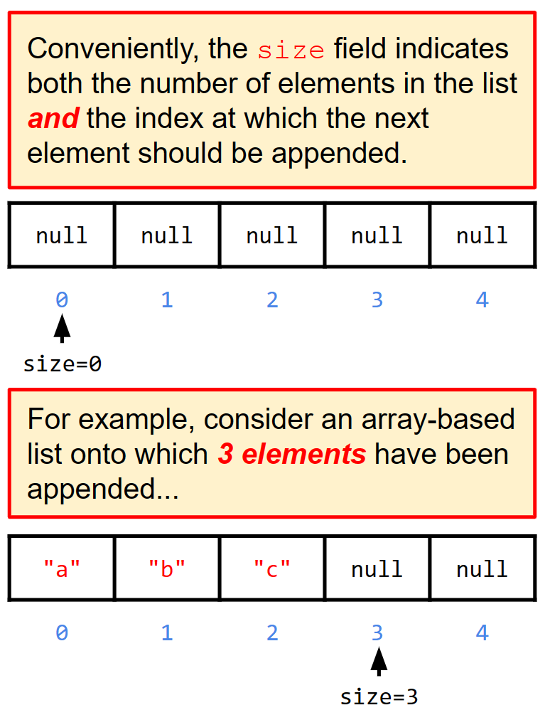
5.17
A Basic Implementation of append
The basic implementation of the append method is pretty straightforward in an Array-based list: simply add the new value at the index to which size refers. Things get a little trickier if the array is full, but we'll worry about that in the next activity!
Open your ArrayList class and navigate to the stubbed-out append method.
Implement the method so that it adds a new value to the index to which size currently points.
Don't forget to increment size!
Don't worry about resizing the array just yet.
Update the main method to append a few values to your ArrayList and print it to standard output.
Don't add more values that the array can hold!

Slide 42
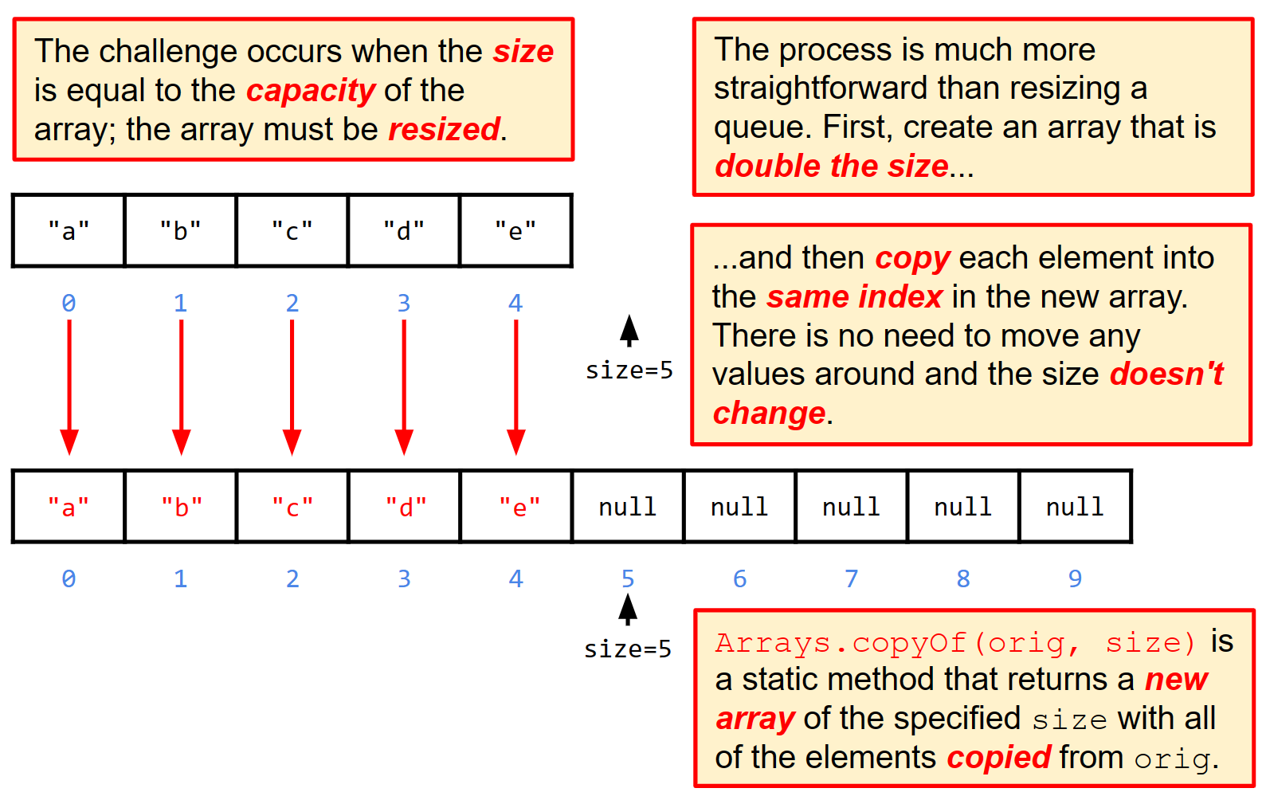
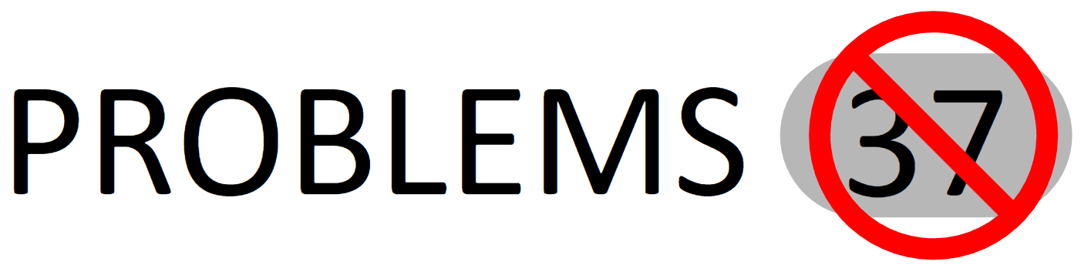
5.18
Resizing the Array in an Array-Based List
When the size of the ArrayList is equal to the capacity of its array, that means that the array is full! The only way to add more elements to the list is to create a new, bigger array to hold all of the elements. The existing elements will need to be copied into the new array before the new element is added.
Open the ArrayList and navigate to the append method.
Before adding the new element, check to see if the size of the list is equal to the capacity of its array.
If so, use Arrays.copyOf(original, newSize) to create a bigger copy of the array first.
Then add the element as you would normally.
Update your main method to append enough values to cause the array to be resized.
Print the ArrayList to standard output!

Slide 43
Linked Lists
Another possible implementation of the list ADT is built using a linked-sequence.
This type of list is called a linked list.
You should recall that a linked sequence is defined as:
The empty sequence, which contains no values and is represented as null.
At least one node that contains:
A value of some type, e.g. a String.
A reference to the next node in the sequence, which may be null.
A linked list keeps track of three values:
The first node in the list, which is also called the head.
The last node in the list, which is also called the tail.
The size of the list - the total number of nodes including the head and the tail.
There are some special conditions that need to be considered:
If the list is empty, both the head and the tail are null.
If there is one value in the list, both the head and the tail refer to the same node.
A linked list is very similar to a node-based queue.
LinkedList
head
tail
size | 3
Node
value | "a"
next
Node
value | "b"
next
Node
value | "c"
next | null
The primary difference is that a linked list provides access by index, meaning that the get and set methods need to search the linked sequence for the node at a specific index.

Slide 44

List Complexity
The expected time complexity for all basic operations on an array list is constant time (O(1)).
The notable exception is append, which has a worst case time complexity of O(n) because of the copy operation, but this should be rare.
The performance of an array list suffers whenever the elements are shifted in the array.
The shift is a linear time (O(n)) operation and is necessary whenever an element is inserted into or removed from the middle of the array.
The expected time complexity for a linked list is very different!
The performance of the append method will always be constant time.
The get, set, insert, and remove operations will also run in constant time if performed at the head or tail of the list.
The performance of a linked list suffers whenever the list has to be searched.
This is a linear time (O(n)) operation and is necessary whenever get, set, insert or remove is performed at any index in the middle of the list.
So how do I decide which implementation to use?
That depends, if you...
...then choose:
- Always Append at the End
- Never Insert or remove in the middle
- Need Random Access
- Know the maximum number of elements
- Always Insert or Remove at head and/or tail
- Don't need random access
- Don't know the maximum number of elements
Array List
Linked List
Understanding which operations are needed the most frequently will help you choose the most efficient implementation to solve your problem.

Slide 45
Java's for-each Loop
The Python for loop assigns the next element in the specified sequence to the loop variable at the start of each iteration.
So far, most (if not all) of the for loops we have written have used Java's "classic" or "C-Style" for loop syntax.
Initialize a counting variable, evaluate a boolean expression, modify the variable.
for(int i=0; i<array.length; i++) {}
Java also includes a syntax that is much closer to Python's for loop called a for-each loop.
Given some sequence like a list or an array, the for-each loop will iterate over the elements in the sequence.
Just like Python's version, a loop variable is assigned to the next element in the sequence before the start of each iteration.
Of course, because it's Java the type of the loop variable has to be declared.
1 for element in an_array:
2 print(element)
The loop automatically terminates after the last element.
The Java for-each loop works exactly the same way other than some small syntactic differences. The type of the loop variable must be specified...
1 for (int element : anArray) {
2 System.out.println(element);
3 }
...and a colon (:) is used instead of "in".

Slide 46
5.19
Using for-each to Iterate Over an Array
Java's for-each loop is a convenient way of iterating through the elements in a data structure without needing to understand how the elements are stored or organized. It works naturally with Java arrays, iterating through the elements in order by index. Try using a for-each loop now to iterate over an array of strings.
Create a new Java class named "ForEach" and define a static method named "forArray" that declares a parameter for a String array.
Use a for-each loop to iterate over the elements in the array and print each on a separate line.
Do not use a "classic" for loop.
Define a main method with the appropriate signature.
Call your method with a String array containing several values of your choice.
Run your new class.
The for-each loop in Java works exactly like the for loop in Python, with some slight syntactic differences.
1 for (int element : anArray) {
2 System.out.println(element);
3 }

Slide 47
5.20
Using for-each with an ArrayList
The for-each loop in Java should work with any data structure. For example, we should be able to use a for-each loop to iterate through the elements of an ArrayList. Let's try it now and see what happens.
The for-each loop in Java works exactly like the for loop in Python, with some slight syntactic differences.
Open your ForEach class and define a static method named "forList" that declares a parameter for a List of strings.
Use a for-each loop to iterate over the elements in the list and print each on a separate line.
Do not use a "classic" for loop.
Call forList from main with an ArrayList containing several String values of your choice.
Run your class.
What happens?
1 for (int element : anArray) {
2 System.out.println(element);
3 }
Notes:
You will get an error that it is not iterable.

Slide 48
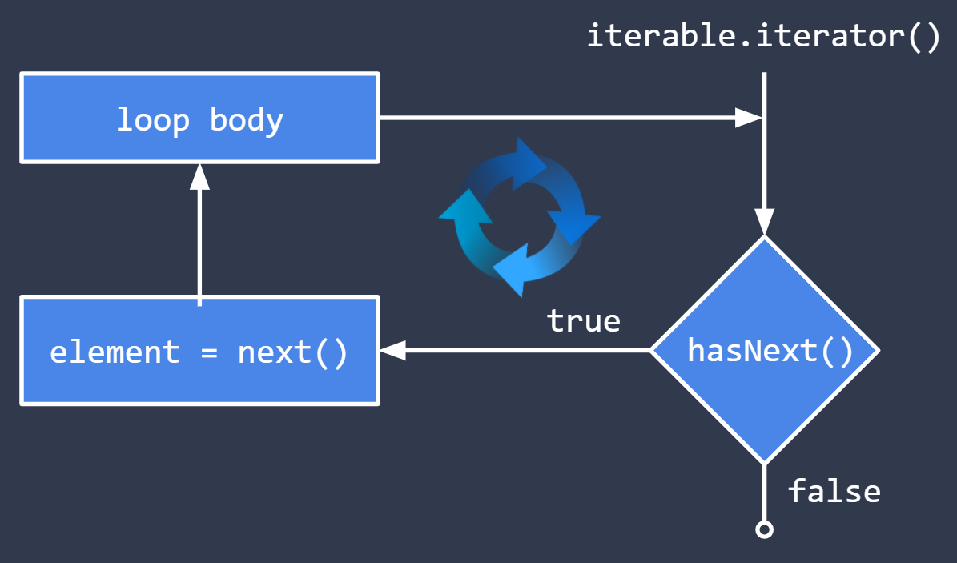
Iterable & Iterator
In Python, the for loop does not automatically work with any kind of data structure.
The special __get__ and/or __iter__ methods must to be implemented in the data structure class.
The same is true in Java - a data structure will not automatically work with a for-each loop.
The java.lang.Iterable interface defines the iterator() method that returns an instance of the java.util.Iterator interface.
An Iterator returns each element in a data structure in some sequential order. It defines basic methods that the for-each loop uses to control iteration.
hasNext() - returns true if there is at least one element in the sequence that the Iterator has not yet returned.
next() - returns the next element in the sequence, e.g. E e = iterator.next()
An Iterator is guaranteed to return each element in the sequence exactly once.
In Java, a data structure must implement the Iterable interface and return a working Iterator in order to work with a for-each loop.
1 for (E element : iterable) {
2 // loop body
3 }
Given some Iterable object, the for-each loop first calls its iterator() method to get its Iterator...
At the start of each iteration, it calls hasNext() on the Iterator to determine if there are any more elements.
If hasNext() returns true, the next() method is used to assign the next element to the loop variable.

Slide 49
Extending Interfaces
In Java, one interface may extend another interface.
e.g. public interface B extends A {}
In this example, the interface B will inherit all of the abstract methods defined in interface A.
Note that both A and B must be interfaces; an interface cannot extend a class.
Under normal circumstances, any class that implements an interface must provide a concrete implementation of all of the abstract methods defined by the interface.
This includes any methods that are inherited from some other interface!
We'd like to modify our List interface so that it extends Iterable, but this introduces a problem: any class that currently implements List will no longer compile!
Neither ArrayList nor LinkedList currently provides an implementation of the iterator() method, which would be required if List extends Iterable.
Java provides a mechanism to circumvent this problem: default interface methods.
An interface may provide a default implementation of one or more of its methods.
If a class implements the interface but does not provide an implementation of a default method, the default implementation is used by...well, default.
One interface may extend another to inherit its methods and establish an inheritance relationship, i.e. B will work with code written for A.
1 public interface B extends A {
2 void bar();
3
4 @Override
5 default void foo() {
6 System.out.println("Default bar!");
7 }
8 }
A Java interface may use the default modifier on a method to provide a default implementation of that method.
A class that implements the interface may or may not provide an implementation for any default methods. If no implementation is provided by the class, the default version in the interface is used.
Notes:
Talk about the default method and what problem it solves
==============================================
interface A {
void methodA();
}
interface B {
void methodB();
}
interface C extends A, B {
void methodC();
}
Now any class that implements C must implement all methods:

Slide 50
A Closer Look at Default Methods
1 public interface A {
2 void foo();
3 }
In Java, one interface may extend another interface to inherit the methods defined in the other interface.
The child interface may add its own methods, and may also provide default implementations of any inherited methods by using the default modifier.
1 public interface B extends A {
2 void bar();
3
4 default void foo() {
5 System.out.println("Default foo!");
6 }
7
8 default void bell() {
9 System.out.println("Default bell!");
10 }
11 }
An interface may also define its own default methods as well.
Default methods are typically used when adding new methods to an existing interface to avoid causing compilation errors in existing classes.
1 public class C implements B {
2 @Override
3 public void bar() {
4 System.out.println("Concrete bar!");
5 }
6 }
A class that implements the interface must implement any abstract methods and may provide its own implementations of any default methods.
Notes:
USE SPARINGLY.

Slide 51
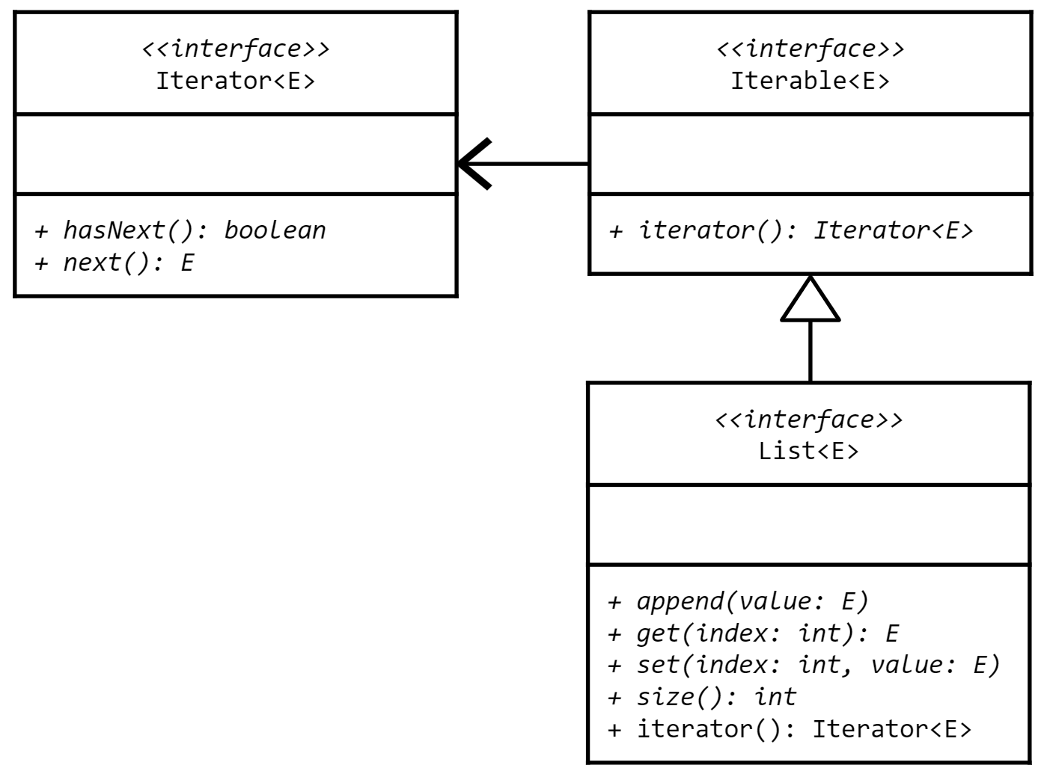
5.21
An Iterable List
Ideally, any implementation of List should be iterable and thus usable with a for-each loop. The best way to ensure this is to modify the List interface to extend the Iterable interface. The existing implementation(s) of List (e.g. ArrayList) will break if we don't add a default implementation of the required method!
Open the List interface and modify it so that it extends Iterable.
You will need to import java.util.Iterator.
Add a default implementation of the iterator() method that throws an UnsupportedOperationException
Your ForEach class should no longer have any errors! That's a good thing!
But what happens when you try to run it now?
A solid line is used in UML when one interface extends another.
This is the same arrow that is used when one class extends another.
Notes:
You will get error.

Slide 52
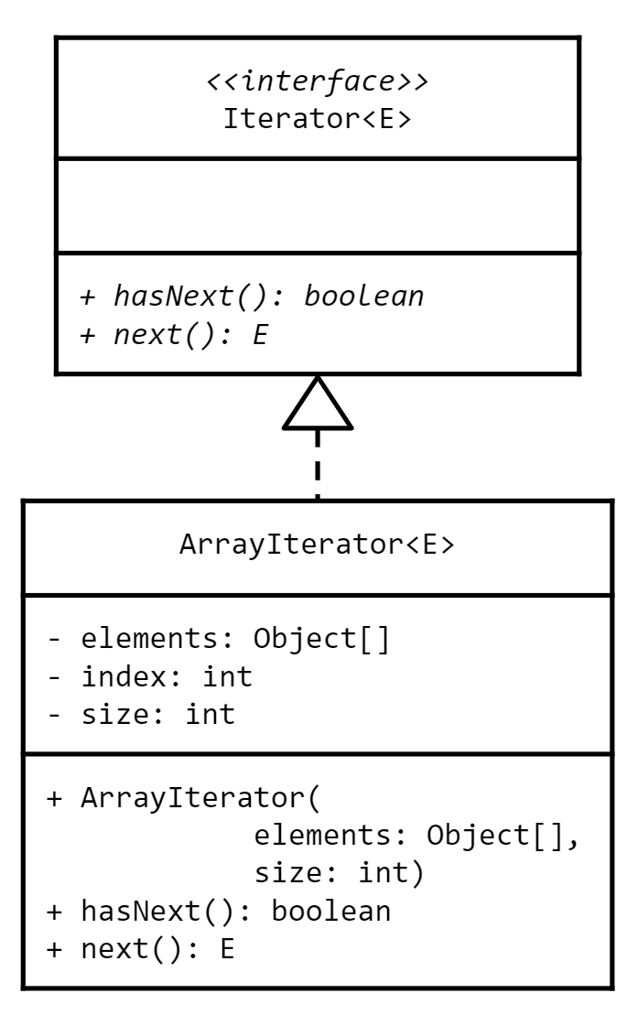
5.22
An Array Iterator
Trying to use the ArrayList with a for-each loop will throw an exception (because the default implementation in the List interface is being used). The first step towards fixing that problem is to implement an Iterator that can iterate through the elements in an array.
Create a new class named "ArrayIterator".
Use the UML class diagram to the left as a guide to implement your iterator.
Use index to keep track of which element should be returned by the next() method.
Note that the array may only be partially full! Use size to determine when the index has passed the last element.
Print a message to standard output in each method including that the name of the method and the value being returned.
Rename the provided ArrayIteratorTest.txt to .java and use it to test your ArrayIterator.
If you need help getting it to work, please raise your hand!

Slide 53
5.23
An Iterable ArrayList
Now that we have an ArrayIterator, we can implement the iterator() method on ArrayList so that it no longer uses the default implementation to throw an exception!
Open your ArrayList class and override the iterator() method inherited from Iterable and List.
Print a message to standard output indicating that the method has been called.
Return a new ArrayIterator using the list's array of elements and its current size.
Try running the ForEach class again.
What happens now?
Do you see how the next() and hasNext() methods are used to control the for-each loop?

Slide 54
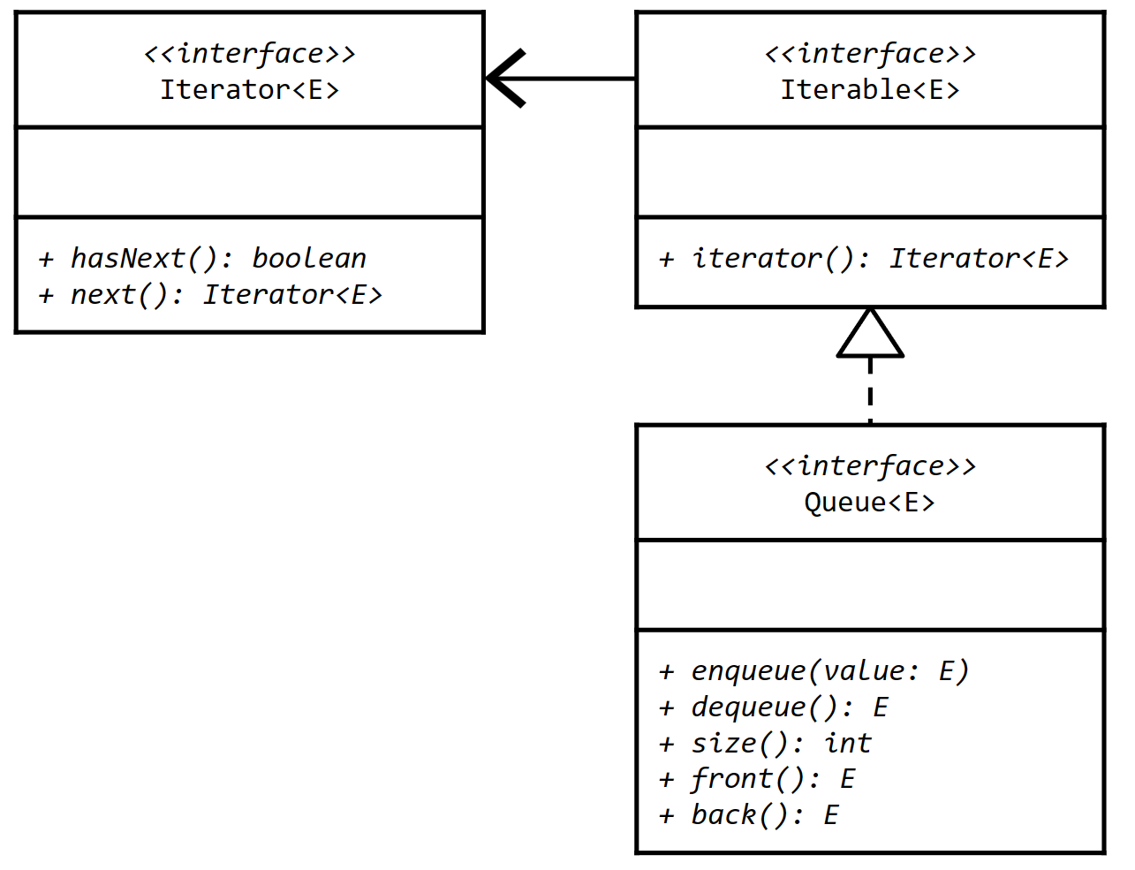
5.24
An Iterable Queue
Technically speaking, a Queue only provides access to the elements at the front and back (and not to the elements somewhere in the middle). Still, it can be a useful exercise to practice making another data structure iterable so that it will work with a for-each loop. Let's try it now!
Open the Queue interface and modify it so that it extends Iterable.
Write a default implementation of the iterator method that throws an UnsupportedOperationExeption.
You will once again need to import the java.util.Iterator interface so that you can use it as a return type.
Open the ForEach class and define a method named "forQueue" that declares a parameter for a Queue.
Uses a for-each loop to iterate through the elements and print them to standard output.
In main, create a NodeQueue and enqueue a few elements before passing it into the forQueue method.
What happens?

Slide 55
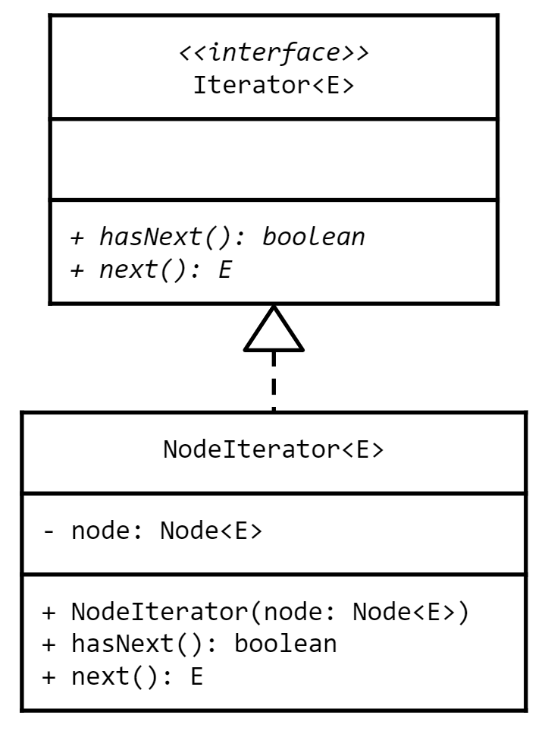
5.25
An Iterator of Nodes
The ArrayIterator will not work with a NodeQueue because it stores its elements using nodes rather than an array. We'll need to implement a new Iterator that can iterate through a series of linked nodes.
Create a new class named "NodeIterator".
Use the UML class diagram to the left as a guide to implement your iterator.
The hasNext() method should return true as long as the iterator has not reached the end of the sequence (node is null).
The next() method should return the value in the node and move to the next node in the linked-sequence.
Print a message to standard output in each method including that the name of the method and the value being returned.
Rename the provided NodeIteratorTest.txt to .java file and use it test your NodeIterator.
If your implementation is not working, raise your hand and ask for help!

Slide 56
5.26
An Iterable NodeQueue
Now that we've got a working NodeIterator, we can update the NodeQueue so that it will work with a for-each loop without throwing an exception. Let's do that now.
Open your NodeQueue class and override the iterator() method inherited from Iterable and List.
Return a NodeIterator that starts at the head of the list.
Run your ForEach class.
What happens now?
Do you see how the next() and hasNext() methods are used to control the for-each loop?

Slide 57
5.27
An Iterable ArrayQueue
One Queue down, and one to go! Let's update the ArrayQueue so that it can also be used with a for-each loop. This may not be as simple as it seems…
Open the ArrayQueue class and override the iterator method inherited from the Queue interface.
Ideally, you would be able to use it to return an ArrayIterator, but the current implementation of that class only iterates from index 0 to size-1. Will that work with an ArrayQueue?
What changes do you think you will need to make to the class?
Will it still work with the ArrayList?!
Use the main method in the ForEach class to create an ArrayQueue, enqueue a few values, and pass it into the forQueue method.
What happens if you dequeue some of the values before calling the method?
What if the array is resized?
What if the front or back wrap around to the beginning?

Slide 58

The Java Collections Framework (JCF)
A data structure is a grouping of related elements.
Data structures are also sometimes referred to as collections.
A collections framework is a unified architecture for representing and manipulating collections.
All collections frameworks contain three things:
Interfaces defining abstract data types (ADTs).
Implementations of the interfaces.
Methods that provide implementations of useful algorithms for things like searching and sorting.
Java's version is the Java Collections Framework (JCF).
Implementing your own collections as we have done is an extremely valuable learning experience with many benefits.
Gain practice with interfaces, inheritance, and polymorphism.
Gain a deeper understanding of how data structures work internally.
Learn about design, design patterns and algorithms.
Practically speaking, however, the implementations provided by a collections framework like the JCF are more robust, reliable, stable, and feature rich than those that we will build ourselves.
When is it OK for me to use the JCF implementations of different data structures in the code that I write for class?
The Java Collections Framework (JCF) provides very flexible and powerful implementations of many different abstract data types.
The general policy for SoftDev II is that, once we have explored an abstract data type in class, you are free to use the corresponding implementation in the JCF.

Slide 59
JCF Implementations
Of course the JCF includes many interfaces and implementations of the data structures that we have looked at so far.
Virtually every interface and implementation in the JCF is generic and so can be used with any type.
java.util.List is the list interface and defines methods for add, get, insert, remove, and iteration as well as many others.
Not surprisingly, there are two main implementations of List that are commonly used.
java.util.ArrayList is array-based.
java.util.LinkedList is node-based.
java.util.Queue is the queue interface and is, oddly enough, implemented by LinkedList.
Java's version of Queue is a little odd because it is iterable and provides random access.
It also uses strange method names like "offer" and "poll" instead of "enqueue" and "dequeue."
java.util.Stack is an implementation of a stack.
It is also a little odd because it iterates backwards (from bottom to top) and provides random access.
I see! It is important for me to understand what a data structure does and how it does it before I use the implementation provided by Java in my code.
Unless otherwise instructed, you may feel free to use any of the JCF interfaces or implementations here, e.g. on your homework or practical exams.
As we continue to explore additional data structures in the coming units, this list will gradually grow to include the entire JCF.

Slide 60
An Incomplete JCF Class Hierarchy
Iterable
Queue
Deque
ArrayDeque
Collection
List
LinkedList
Map
+add(E)
+contains(E):boolean
+remove(E)
+size():int
+put(key, value)
+get(key): value
+contains(K):boolean
+size():int
ArrayList
Stack
Legend
HashMap
TreeMap
Interface (italics)
Set
HashSet
Implementation
OK to use (green)
SortedSet
NavigableSet
TreeSet
Notes:
The data structures we have covered and that are available to use are in green.

Slide 61
 | Generics public class Container<T> { private T value; public Container(T value) { this.value = value; } public T getValue() { return value; } public void setValue(T value) { this.value = value; } } Container<String> c = new Container<>("abc"); String value = c.getValue(); | Combining Generics public class Warehouse<T> { private Container<T> container; public Warehouse(T value) { container = new Container<>(value); } public Container<T> getContainer() { return container; } } Warehouse<String> wh = new Warehouse<>("abc"); Container<String> c = wh.getContainer(); String value = c.getValue();
 |  | Extending Generics public class Locker<T> extends Container<T> public class Folder extends Container<String>
 | Java’s for-each loop for (int element : anArray) { System.out.println(element); } | Iterable & Iterator iterator() hasNext() next()
 | Extending Interfaces public interface A public interface B extends A
Unit 5: Data Structures I

Slide 62
 | Default Methods public interface A { default public void greeting() { System.out.println(“Default Hello!”); } } public interface B extends A { @Override public void greeting() { System.out.println(“Howdy!”); } } | JCF Implementations java.util.List java.util.ArrayList java.util.LinkedList java.util.Queue java.util.Stack
Unit 5: Data Structures I

Slide 63


Summary & Reflection
What is one thing that you wish you knew more about as we move forward?
Abstract Data Types
Java Interfaces
Nodes & Linked-Sequences
Queues
Node-Based
Array-Based
Lists
Array-based
for-each Loops
Iterable & Iterator
ArrayIterator
NodeIterator
The JCF
What is one new thing that you learned today?
What one question do you have about today’s class?
Please answer the questions above in your notes for today.

